Slide 1
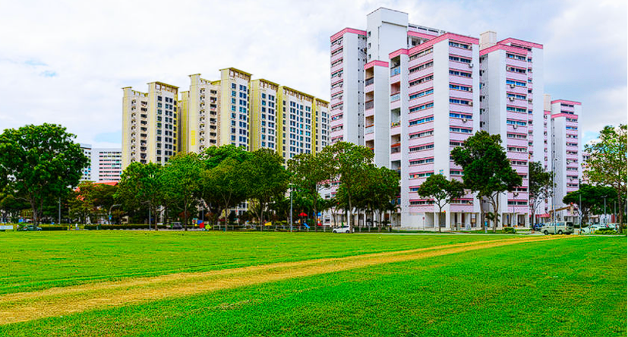
HDB Resale market 2020-2024 report
(SCTP) Associate Data Analyst Capstone Project
Chua Kee Siong (20 Jan 2025)
Associate Data Analyst
PropertyGuru-888 Pte.

Slide 2
CONTENTS
Introduction
HDB (Housing Development Board) Resale dataset
Data (Cleansing & Transformation)
Exploratory Data Analysis (EDA) & Visualization
Machine Learning Modelling (Linear Regression, Random Forest Regressor, Decision Tree Regressor model)
Results | Recommendations | Limitations

Slide 3
addressing PROBLEMS
Importance: 77.8% Singaporeans live in public housing thus a big market HDB property companies need ways to predict sales prices in order to formulate optimal business plans
Variables/features of importance that impact HDB resales prices?
Machine learning model solutions to predict resales prices?
Any limitations to data model and way to address it?
Visualizations for predicting resales prices?
Recommendations?

Slide 4
HDB Resale dataset
Data Summary: Data comprise of HDB resale transaction prices from (2000 to 2024). CSV format.
Column lists: town names, flat types, floor area sqm, flat model, lease commence date, resales price, remaining lease & month.
Dataset is large enough and comprehensive for deep dived into predicting trends and insights into the HDB flat resale market.
Data is pre-processed through normalization and cleaning to ensure readiness for analysis.
Source: https://github.com/rick7122003/Kee-Siong/blob/main/README.md

Slide 5
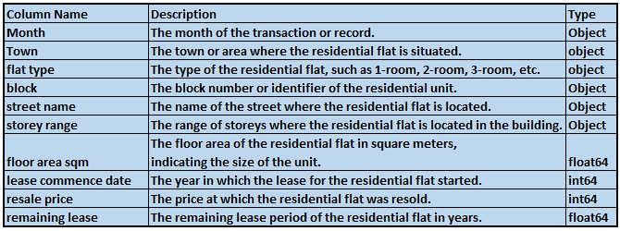

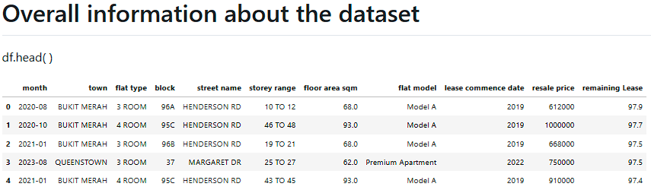
HDB Resale dataset: Original Parameters

Slide 6
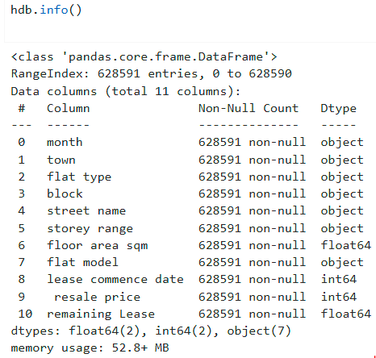

HDB Resale dataset
Data Characteristics and Quality
Dataset Characteristics (code):
Size: 628,591 rows, 11 columns.
Memory usage: 52.8+ MB.
Data Types: 2 float64, 2 int64, 7 objects.

Slide 7
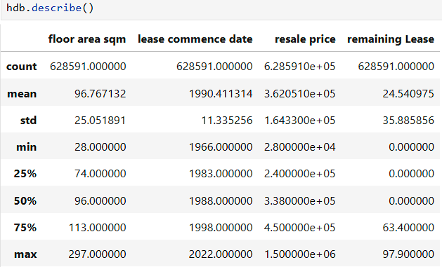

Data Resale dataset: Statistics
Data Characteristics and Quality
Descriptive Statistics (code)
Outliers:
High prices (max: $1,500,000) and very low prices (min: $28,000) may indicate outliers.
Large flats (max: 297 sqm) and very small flats (min: 28 sqm) may be investigated for consistency.

Slide 8
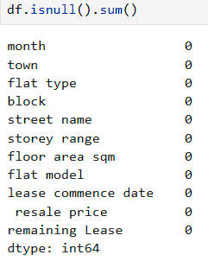
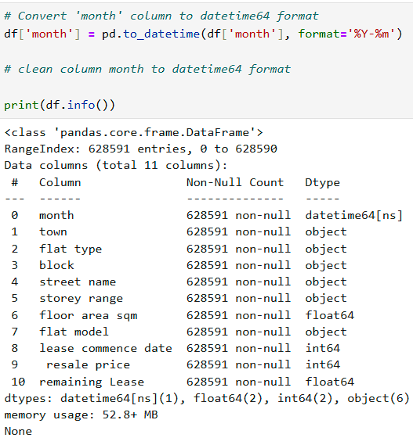

Data cleansing & Transformation
Data Cleaning, Normalizing
& Transformation (code) :
The dataset is comprehensive, with no missing & null values after post-cleaning.
Month is re-formatted for better analysis
The shape and memory usage make it suitable for detailed analysis.

Slide 9
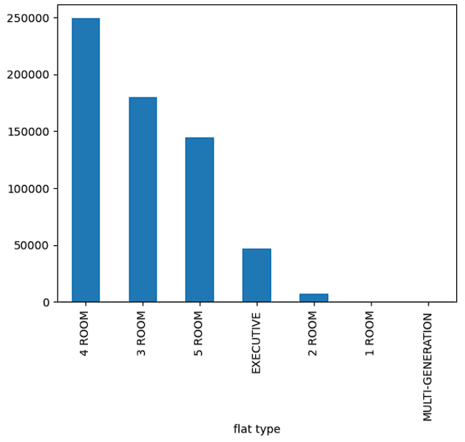
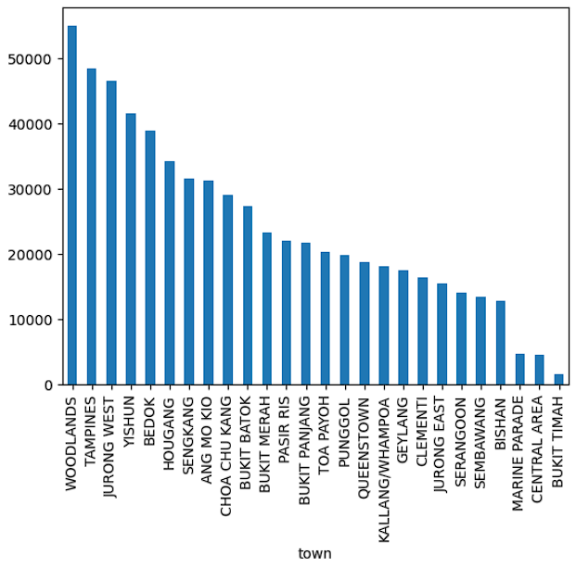
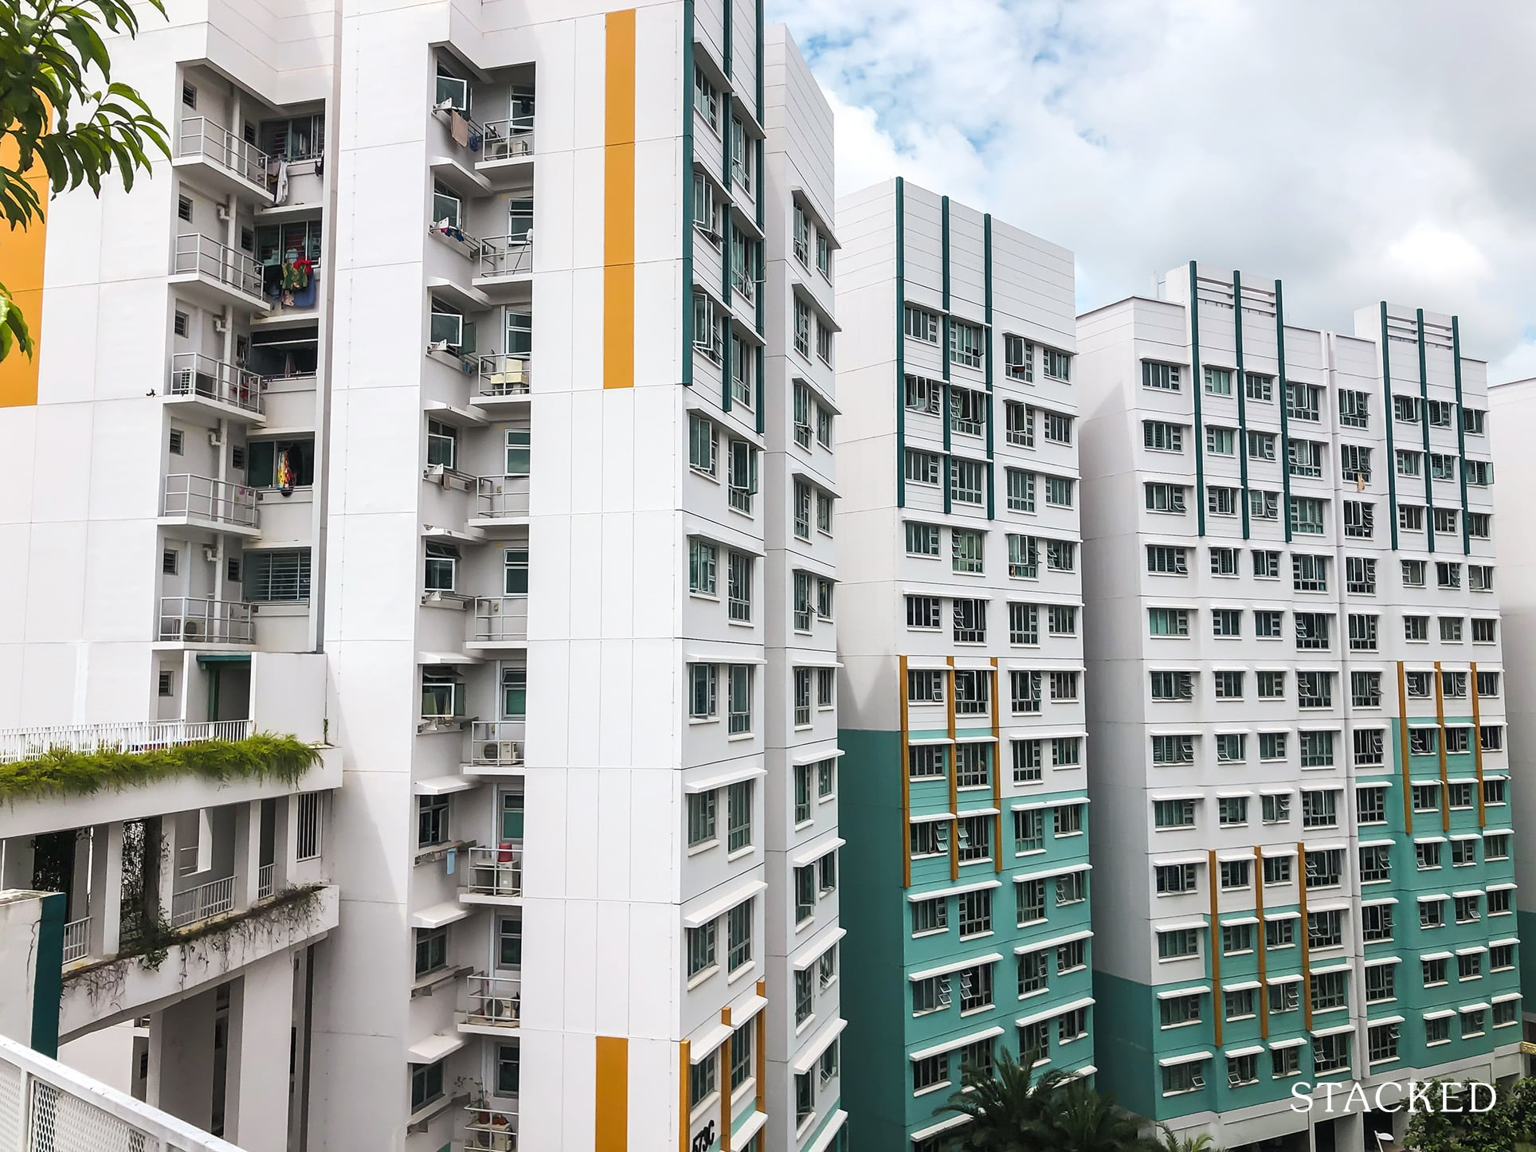
Exploratory Data Analysis (EDA)
Bar chart visualization of HDB resale data to discover insights & trends over 2020 to 2024
Highest sales- 4 room flat type
Highest flats sold - Woodlands Town

Slide 10
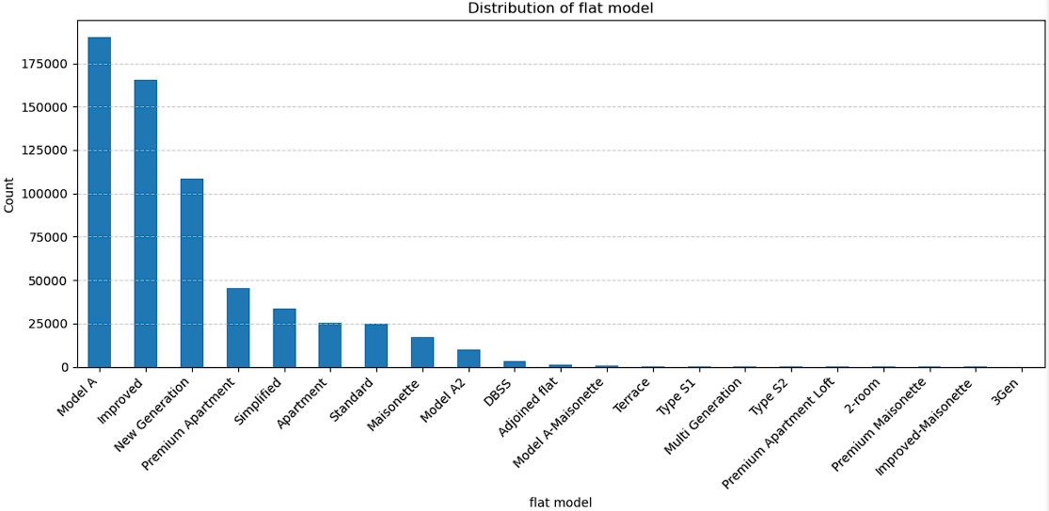

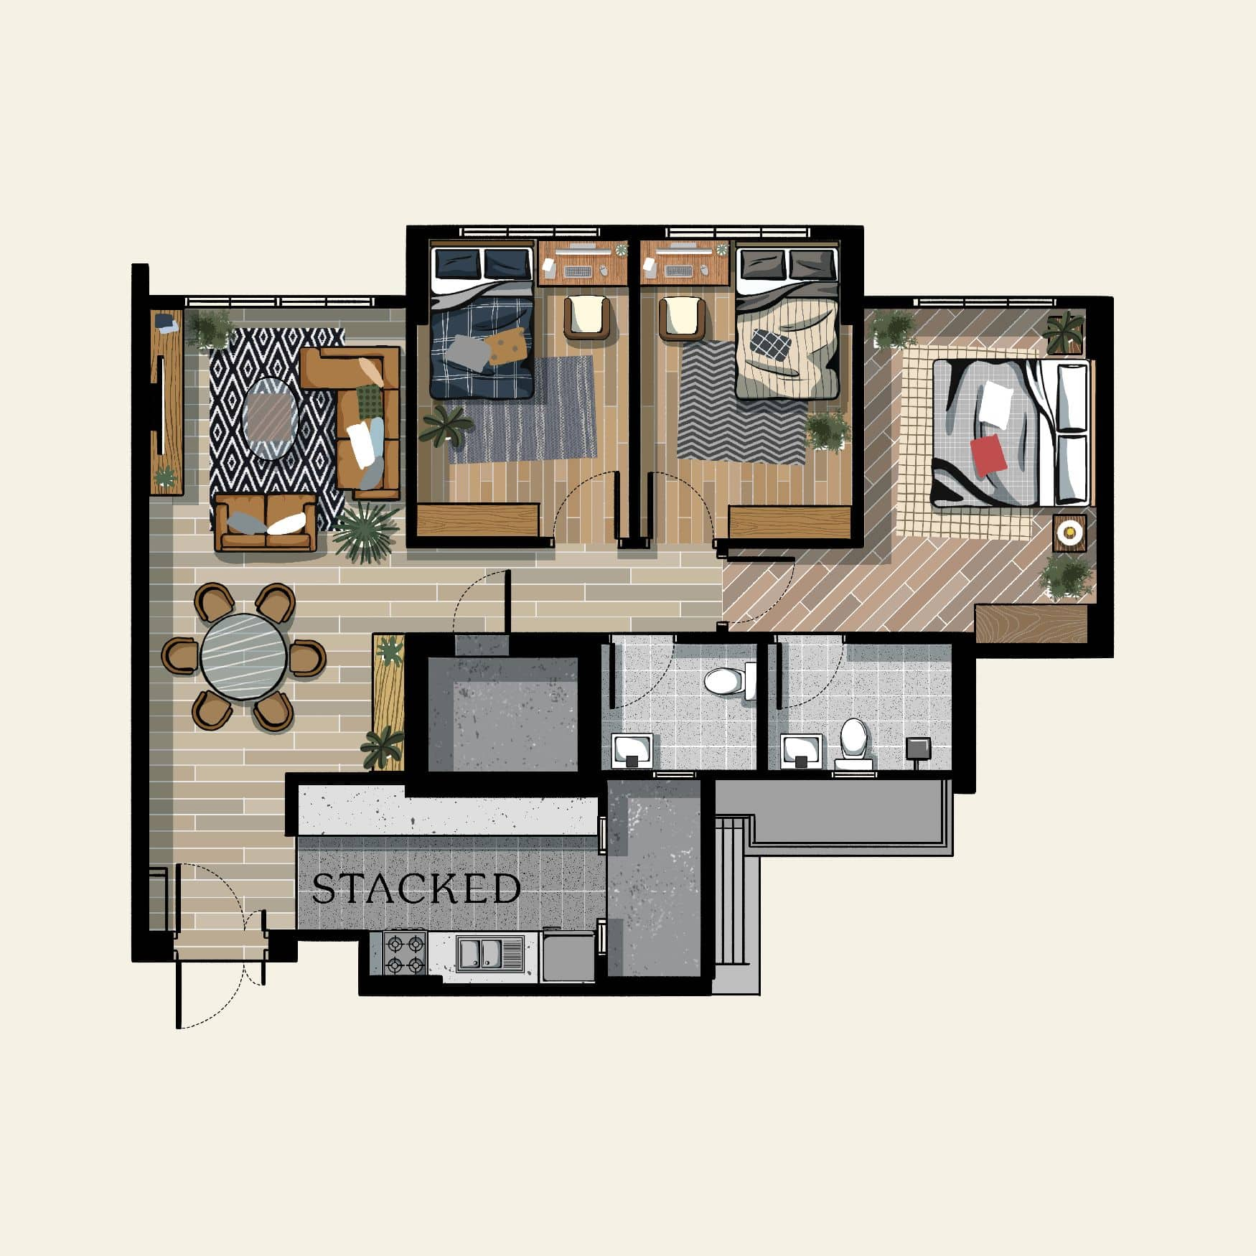
Exploratory Data Analysis (EDA)
Bar chart visualization of HDB resale data to discover insights & trends over 2020 to 2024
4 room flat type has highest sale count, they are mostly of the stock of Model A
Follow by flat model of Improved and New Generation models

Slide 11
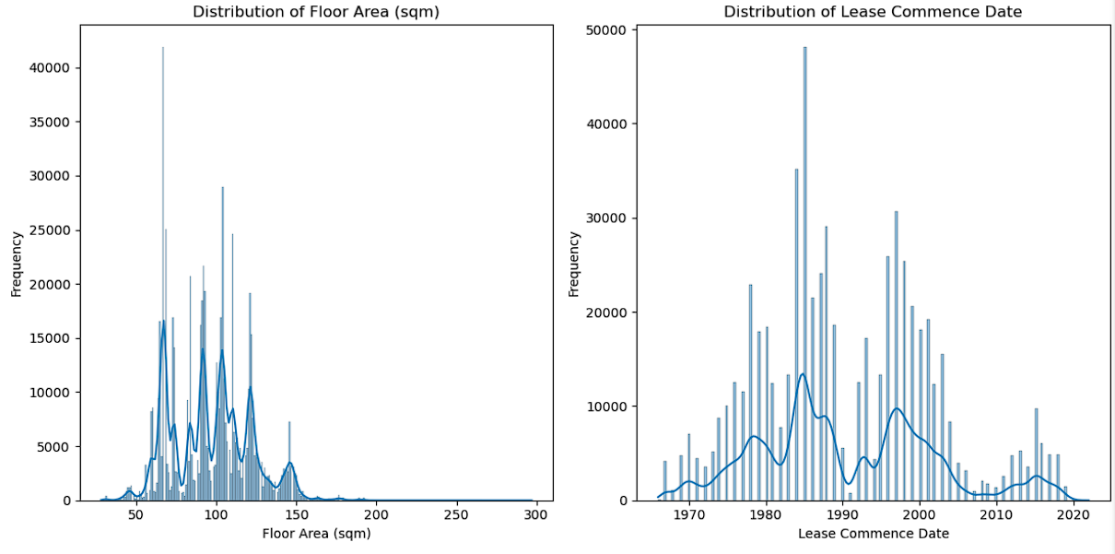
Exploratory Data Analysis (EDA) Discovering outlier spikes, trends from frequency distribution of HDB resales influencing resale prices
Histogram charts. By floor area, Lease commence date
Floor area (sqm):
Range Between 28-297 sqm
Limited: Smaller to larger units
Lease commence date:
Concentration flats builds
from late 1970s to 1990s slowdown
Gradual increase
of newer leases likely due
To changing housing policies
& population growth i.e.

Slide 12
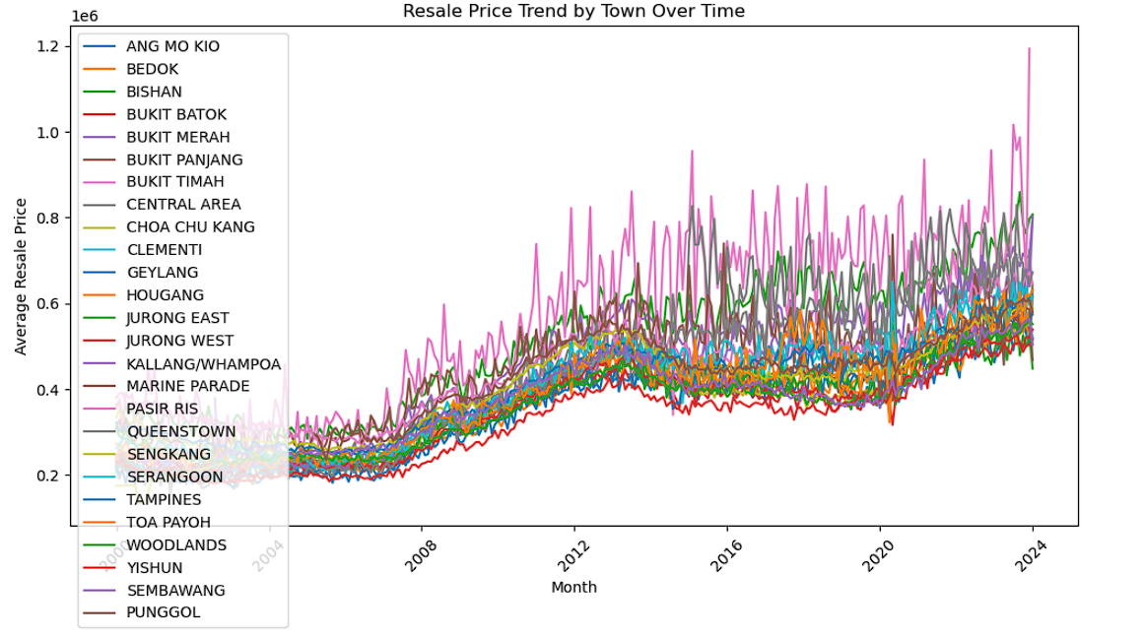
Exploratory Data Analysis (EDA)
By Town
This resale price by town over time, we can see prices consistent appreciation in central area like Bishan.
Marine Parade & Queenstown has higher rate increases among other towns.
While Pasir Ris has the highest outliers resale price increases.
Jurong west, Yishun and Sembawang towns has the lowest price range appreciation

Slide 13
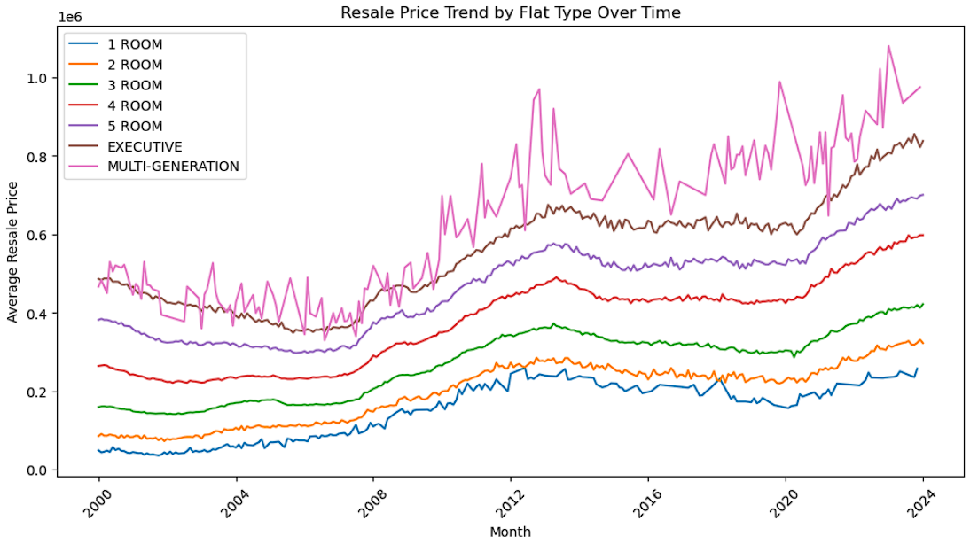
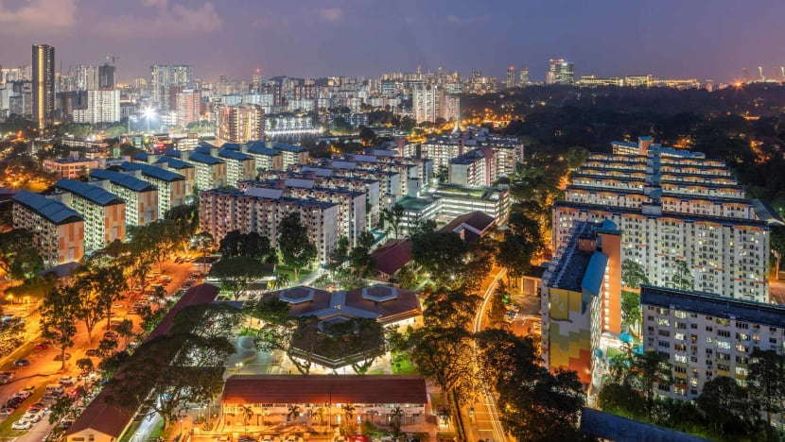
Exploratory Data Analysis (EDA)
By Flat Type
Line chart : average resale price trends by flat types over time.
Flats such as Multi-generation, Executive, 5 Room, 4 room seems to be in higher price range group
This group experiences a higher resale price appreciation from 2000 to 2024 compared to 1, 2, 3 room lower range pricing group.
Reasons could be attributed to rise of GDP, policy, income rises, inflation and standards of living. i.e. HDB MOP rule & other exceptions if flat owner is deceased the flat has to be sold

Slide 14
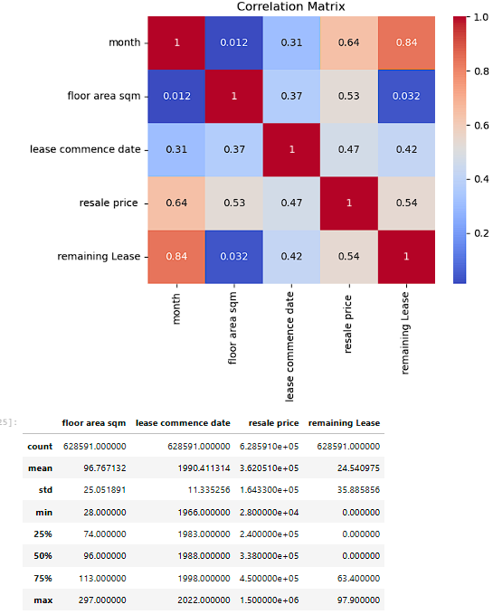
Exploratory Data Analysis (EDA)
By all variables
Key Correlations to resale price:
Floor area sqm and resale price show a strong positive correlation (0.53)
Remaining lease (0.54) and resale price has strong positive correlation
Lease commence date and resale price have a moderate positive correlation (0.47)

Slide 15
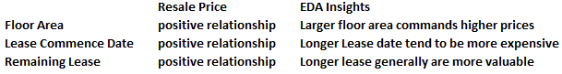
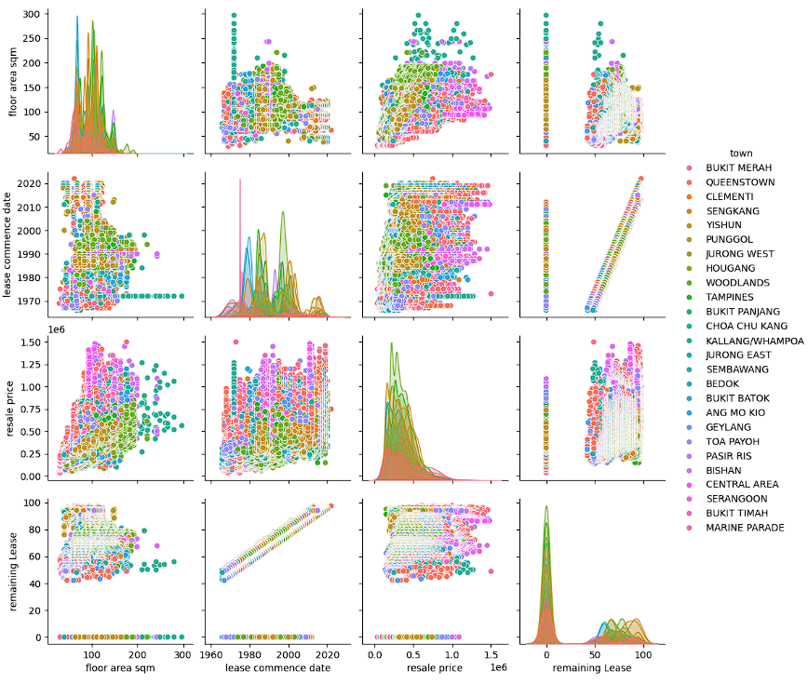
Exploratory Data Analysis (EDA)
Pairplot: Scatterplots matrix
Comparing Between 2 variables.
Easy EDA analysis to detect
correlations, outliers or
distinct subgroups

Slide 16
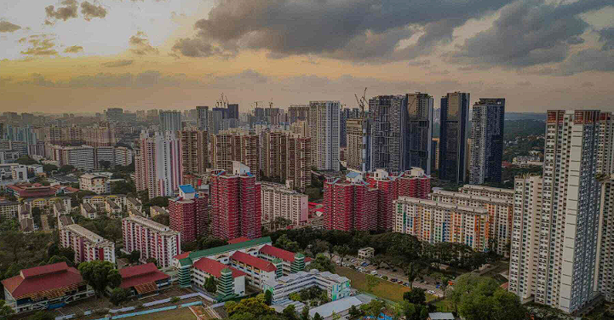
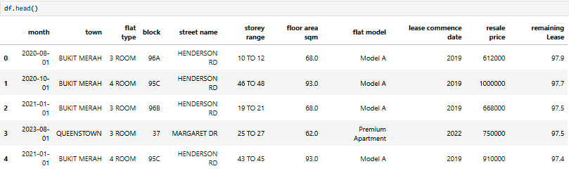
EDA insights and implications
After EDA exploration Process:
We select specific column “Resale Price” to compare between “town”, “lease Space Sqm”, “flat type”, “flat model”, “remaining lease” and “lease commence date” as variables best showing meaningful relationships on resale price
Above variables show moderate to strong correlations to resale prices

Slide 17

Machine Learning ModelLING: Development
Three models were selected for evaluation:
Linear Regression Model
Random Forest Regressor Model
Decision Tree Regressor Model

Slide 18
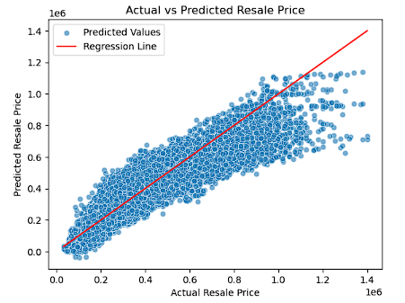
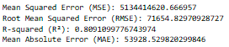
Machine Learning Model: Linear Regression
Observation:
The scatter Plot shows strong positive correlation
Between actual and predicted resale prices
Relative high R-square values (0.809) but high Mean Absolute Error (53928.52)

Slide 19
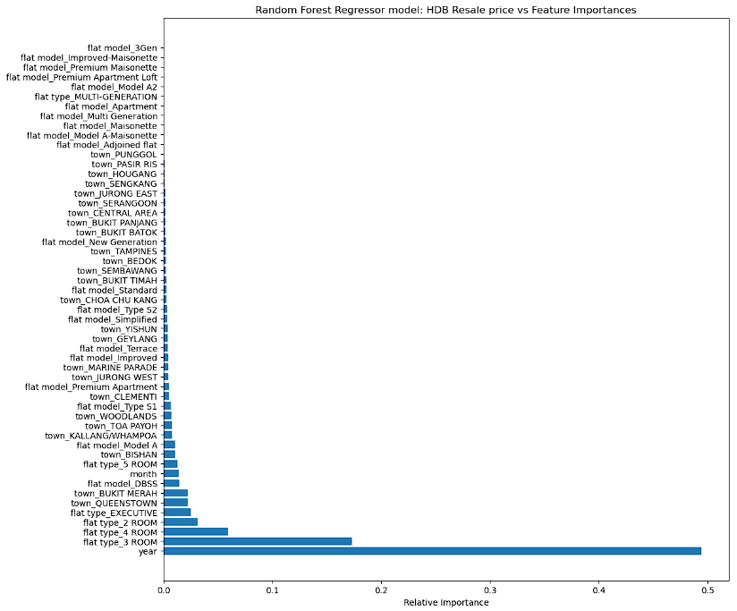
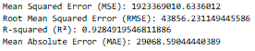
Machine Learning Model: Random Forest RegressoR
Observation:
Chart highlights importance of different features in predicting HDB resale prices. Features are ranked based on their contribution to the model’s accuracy.
Relative importance features highlighted are flat type and town columns.
R-squared (R2): R2 value of 0.92 explains well on feature importance.
Mean Absolute Error (MAE): 29068.59 is the lowest MAE among the three models

Slide 20
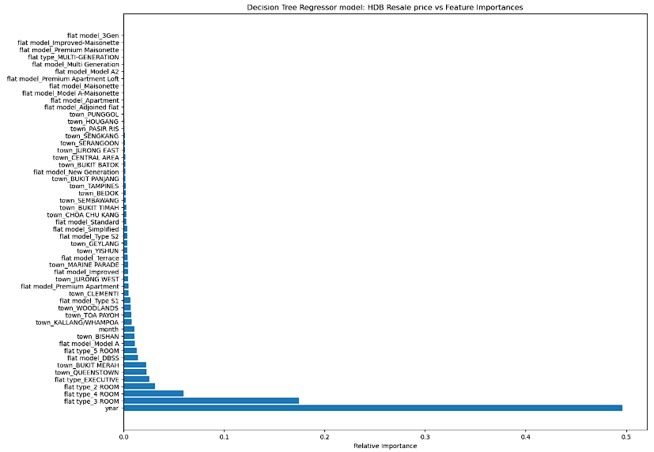
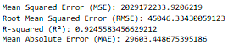
Machine Learning Model: Decision Tree RegressoR
Observations
Chart represents relative importance of different features in predicting HDB resale prices
Flat Type: Highest feature importance, suggesting that the number of rooms is a strong predictor of resale price. Town: Locations like Bukit Merah, Queenstown and Bishan have significant influence, indicating that location plays a crucial role in determining resale values.
R-squared (R2): 0.92, similar as Random Tree Regressor Model.
Mean Absolute Error (MAE): 29603.44, error is higher then Random Tree Regressor Model

Slide 21

Machine Learning Models
Model findings:
Linear Regression Model (3rd place):
R-squared: 0.809, Accuracy lowest among the three model
High magnitude of error: MAE: 53928.52
Random Forest Regressor Model (1st place):
Key features: flat type and town.
Has high R-square (0.92) and least MAE: (29068.59)
Decision Tree Regressor Model (2nd place):
Key features: flat type and town
Has high R-square (0.92) and place 2nd in MAE (29603.44)

Slide 22
MACHINE LEARNING MODELS: RESULTS
Results:
Random Forest Regressor Model found suitable for predicting HDB resale prices.
Best R2 and MAE readings. Captures non-linear relationships
Robustness to Outliers, handle high-dimensional data well.
Significance of flat type and town location impact on resale prices.

Slide 23
Results, Recommendations
Recommendations:
Adopt Random Forest Tree Regression Model for property forecast planning
Focus on location and flat type:
Location Focus: high price appreciation towns like Queenstown & Bukit Merah
Flat Type: higher range 4-5,Multi-Gen, Executive Flats | Low Range 1-3 Room Flat
Lease Length:
Prioritize properties with longer remaining leases to minimize price depreciation
Incorporate lease length as a key feature in the model.

Slide 24
Results, Recommendations, limitations
Limitations:
Random Forest Regressor Model problem: Overfitting, Lack of Extrapolation, Bias Towards Dominant Features
Datasets not integrated for Analysis: More research time needed to integrate Government policy data, Economic shocks, Supply chain issues, Inflation, Demographics changes may affect the accuracy of the model
Addressing limitations:
Hyperparameter Tuning & better Data Preprocessing
Create new features to capture non-linear relationships and variable interactions

Slide 25
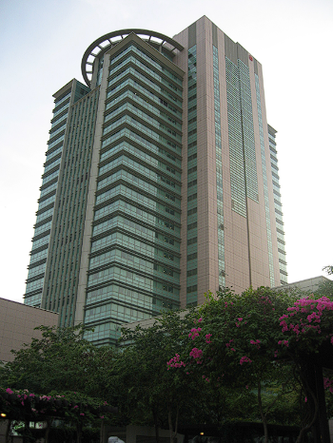
THANK YOU
Chua Kee Siong
rick7122003@gmail.com
HDB HUB, Toa Payoh
Linkedin: https://www.linkedin.com/in/chua-kee-siong-rick-01772544/
Github: https://github.com/rick7122003/Kee-Siong/blob/main/README.md

